Slide 1
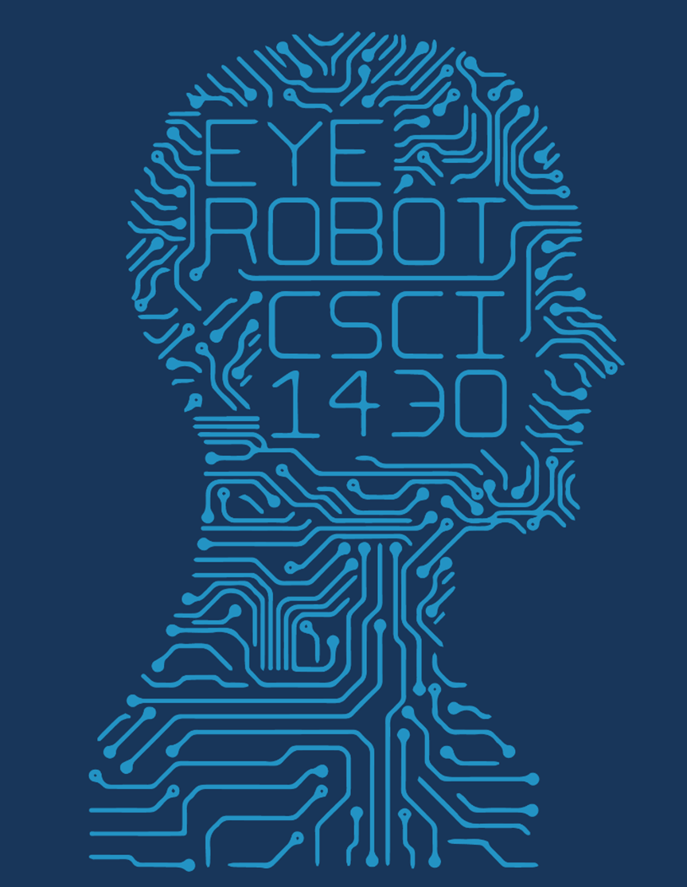
Image Colorization
Sigmoid Sibs
Alice Marbach and Amos Jackson

Slide 2
Classification approach
Zhang et al.
Multimodal
Objects with different possible colors

Slide 3
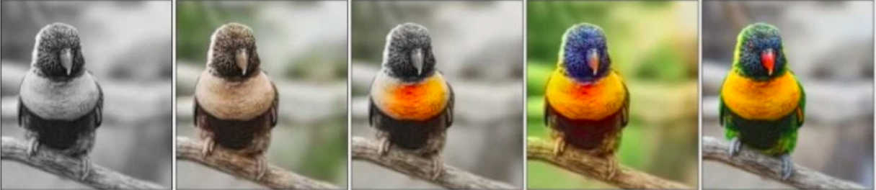
Color rebalancing
Reweight rare colors
Avoids desaturation
Input
Regression (Dahl 2016)
Zhang without rebalancing
Zhang with rebalancing
Ground truth

Slide 4
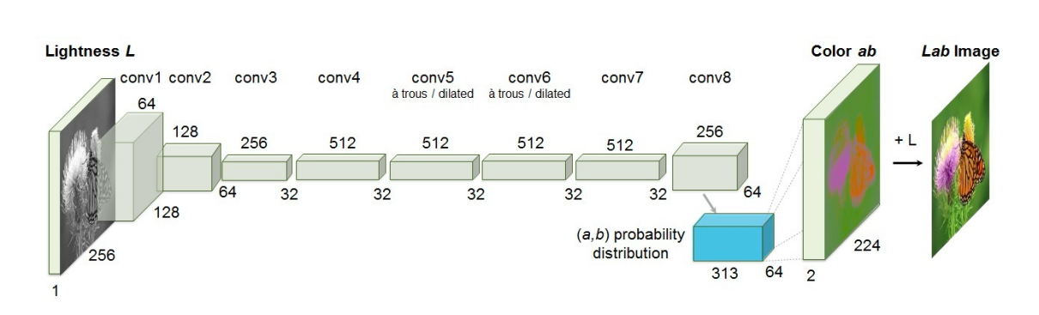
The Architecture & Data
ImageNet
CIELab colors
K-means clustering quantization

Slide 5
No Meaningful Output Yet…
Sources:
Zhang et al. Architecture
https://arxiv.org/pdf/1603.08511.pdf
Rebalancing colors
https://techcrunch.com/2016/03/31/this-neural-network-hallucinates-the-right-colors-into-black-and-white-pictures/

